Slide 1


Microsoft Power BI

Slide 2
Project Title: Superstore Sales & Profit Dashboard Presented By: J.Akshitha Reddy Tools Used: Power BI, DAX, Excel Dataset: Sample Superstore (Kaggle) Date: June 27, 2025

Slide 3
Objective: To build an interactive and business-oriented dashboard that presents actionable insights into sales, profit, customer segments, product categories, and regional performance using the Sample - Superstore dataset.
Business Goals:
Analyze sales and profit performance over time
Identify best and worst performing categories/regions
Enable data-driven marketing, inventory, and pricing decisions
Dataset Highlights:
Records: ~10,000+
Features: Sales, Profit, Segment, Region, Sub-Category, Ship Mode, Date

Slide 4
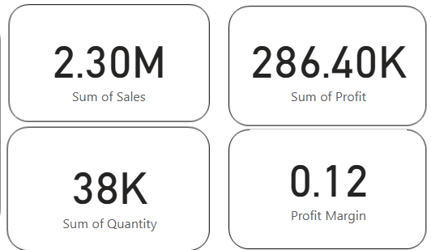
KPI’s Summary
KPI | Value Example (from Dashboard) | Insight
💵 Total Sales | ₹2,297,201 | Overall revenue from all orders
💰 Total Profit | ₹286,397 | Net earnings across categories and regions
📦 Total Orders | 9,994 | Business volume captured
📊 Profit Margin | ~12.5% | Efficiency in turning sales into profits

Slide 5
Visual Trends & Performance Breakdown
Include screenshots and label these insights clearly:
📈 Sales Trend (Line Chart by Month-Year) ➤ Clear seasonality: Peak sales during Nov–Dec (holiday season) ➤ Gradual growth throughout the year
🗺️ Sales & Profit by Region (Stacked Bar or Map) ➤ West region leads in both sales and profit ➤ Central has moderate sales but low profit — potential cost issue
🧾 Top Categories & Sub-Categories (Bar/Donut) ➤ Technology is top-performing (Phones, Accessories) ➤ Tables and Bookcases are unprofitable → action needed
🧠 Customer Segment Impact ➤ Corporate segment shows higher profit per order ➤ Home Office orders more frequently but with lower margin

Slide 6
Insights & Recommendations
📍 Business Insights:
30% of total annual sales occur in just 2 months (Nov–Dec)
Corporate customers drive higher profit per sale
Furniture sub-category (Tables, Bookcases) is consistently loss-making
West region = strategic opportunity; Central = efficiency issue
✅ Recommendations:
Focus Q4 inventory on Phones, Chairs, and Copiers
Audit high-sale low-profit categories (like Tables) for cost leakage
Launch segmented campaigns targeting Corporate clients
Review Central region operations – shipping, discounts, or vendor costs

Slide 7
Relaunch the add-in
Microsoft Power BI
After you install the add-in, you can launch it by choosing the add-in button on the Insert tab
On the Insert tab
Insert
My Add-ins
Need more help?
Return to your internet browser or copy this link into your browser:
https://pages.store.office.com/addinsinstallpage.aspx?rs=en-IN&assetid=WA200003233&isWac=True&ui=en-US&ad=IN

